Slide 1

CPE 490 Embedded Systems
RMS values
Average, and Apparent Power
Phase Angle, Power Factor
Sampling rates
Project Math strategy

Slide 2
ALL LABS AND HW#4 DUE
You must turn in labs 1-10 and HW#4 next Friday the 25th. I will not accept them after that point.
HW#5 is posted and due also next Friday

Slide 3
Exam 2
Review for the exam a week from today
Exam on the following Thursday.

Slide 4
Senior Moment 3: Luke 16 (ESV)
Vs 10 – 13: 10 One who is faithful in a very little is also faithful in much, and one who is dishonest in a very little is also dishonest in much. 11If then you have not been faithful in the unrighteous wealth, who will entrust to you the true riches? 12And if you have not been faithful in that which is another’s, who will give you that which is your own?
Notes:
The corporate world says go after money, go after titles, go after power and influence
God says be faithful with the little things, be faithful with what others have given you. First be excellent with what is given to you. These other things if it id Gods will, will be given to you. Because you will have money, influence, and the title in order to bless others.

Slide 5
Senior Moment 3: Luke 16 (ESV)
13No servant can serve two masters, for either he will hate the one and love the other, or he will be devoted to the one and despise the other. You cannot serve God and money.”
14The Pharisees, who were lovers of money, heard all these things, and they ridiculed him. 15And he said to them, “You are those who justify yourselves before men, but God knows your hearts. For what is exalted among men is an abomination in the sight of God.
Notes:
The corporate world says go after money, go after titles, go after power and influence
God says be faithful with the little things, be faithful with what others have given you. First be excellent with what is given to you. These other things if it id Gods will, will be given to you. Because you will have money, influence, and the title in order to bless others.

Slide 6
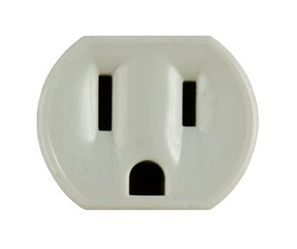
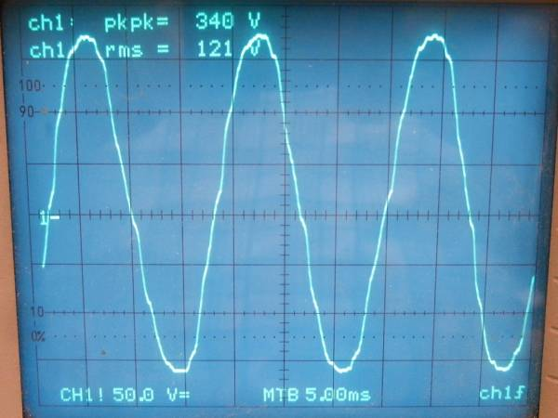
What Would I See?
I hook up an oscilloscope to a wall socket
But I thought it was 120 VAC

Slide 7
Average or DC Voltage
The average voltage can be determined by:
Where T is the period of the waveform.
In discrete samples this can be done by accumulating evenly spaced samples an then divide by the number of samples

Slide 8
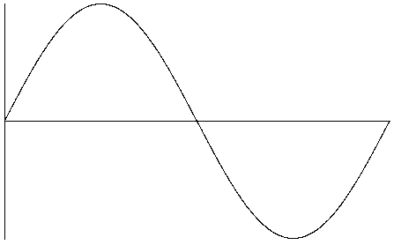
DC Voltage of a Sine Wave
What is the DC voltage of this waveform?
What would it be if your didn’t have the same time between each sample?
What would happen if you had a DC offset in the signal?
Notes:
Of course the average value = 0
It you do not have even sampling then the positive samples will not exactly cancel out the negative and some value will be left
If you had a DC offset the average value would be that offset.

Slide 9
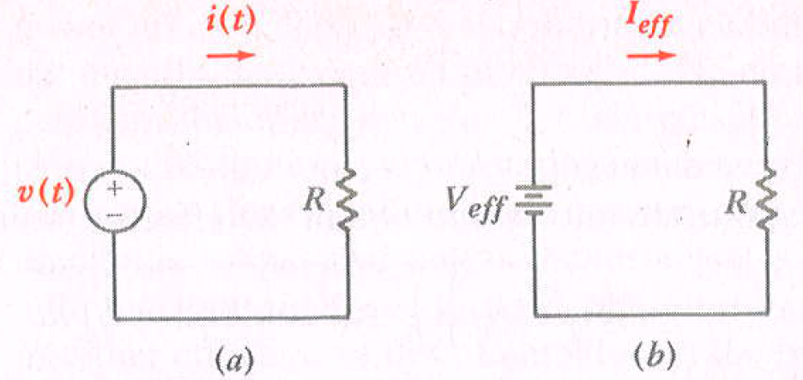
Effective Current or RMS value
Notes:
Could have the done the same with V^2/R

Slide 10
Voltage RMS value
The RMS voltage value of a waveform can be calculated as:
To “see” RMS go from the outside in Root, then the Mean, then the square.

Slide 11
RMS Value of Sinusoids
Notes:
The half angle trig identity is used to handle the cos squared value
The integral of the cos function is over a multiple of its period and therefore must be zero.

Slide 12
RMS Current and Voltage
But what if the current or voltage is not a perfect sinusoid.
The previous slide is invalid
True RMS calculation must average the instantaneous samples therefore in you meter design you will do this calculation at equally sampled points:

Slide 13
Instantaneous Power
Defined as
For example
Notes:
Not a constant value and a periodic value

Slide 14
Average Power
Average of the instantaneous power over n periods

Slide 15
Average Power Example
Notes:
A trig identity is used cosx cosy = ½[cos(x-y) + cos(x+y)]

Slide 16
Average Power Example
Notes:
Note in the last step the integral of the periodic 2nd term is zero the other is a DC value so its average is the same
We can ignore the sense of the (positive or negative) cosine term power will always be positive.

Slide 17
Power
Power across a resistor will always have a phase angle of 0 and thus:
P = ½ Vm^2/R = ½ Im^2*R
Power across a capacitor or inductor will always have a phase angle of 90 degrees thus:
P = 0 w
Apparent Power = P_{a}=V_{eff} * I_{eff}

Slide 18
Power Factor

Slide 19
RMS and Average Periods
When finding the RMS or average value of a sinusoidal signal you must average over a integer number of periods to get no errors.
Is there a way to pick a sampling period that will produce no errors for both a 50 Hz and 60 Hz periodic signal?

Slide 20
Period Criteria
Since 60 Hz has a smaller period we will increase the integer number of periods (N) of a 60 Hz wave form until a 50 Hz period will evenly divide into the period (M)

Slide 21
Conclusion
If I sample the waveform over the time period of 6/60 = .1 seconds then both 50 and 60 Hz signals will not have errors produced.

Slide 22
Sampling
The project requires that we must sample at least 5 faster than the Nyquist rate.
The Nyquist rate is 2 time the upper bandwidth of the signal. Assuming perfect sin waves the maximum frequency content is 60 Hz
The sampling rate must divide the sample time by a even integer

Slide 23
Sampling
Therefore the slowest we can sample is:
This rate goes into the sampling period of .1 seconds an even 60 times.

Slide 24
How much Memory
If we need to take a sample every 1/600 of a second for .1 seconds
The number of samples per signal will be 60 samples
The samples can be up to 12 bit values so each will take a word or two bytes. Therefore two signals will take 120*2 = 240 bytes.
This is a minimum, since the device has 30Kbytes you could do faster sampling as long as you have enough processor bandwidth.

Slide 25
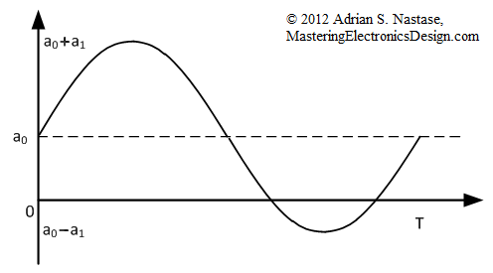
DC Offset
In the semester project a DC offset is added to the input signals so no value is below ground.
The RMS value of a DC signal is the DC signal.

Slide 26
Just Average
To find the average of a sampled signal we sum the samples and divide by the number of samples (in this case 60 samples)
Therefore a simple accumulation of the 60 samples should be kept, at the 60 sample the accumulation should be divided by 60 and this value is the average.
The average value should be subtracted out of all samples because we have offset the signal.

Slide 27
What Can be Calculated Concurrently?
We have see that a simple accumulation of the samples is effective in finding the average or offset voltage.
We will prove that the only other value needed is the sum of the squares of the signal samples.
We will derive a way that allows us to not have to go back and subtract the offset.
This algorithm will allow us to figure out all values that we need while we are collecting samples

Slide 28
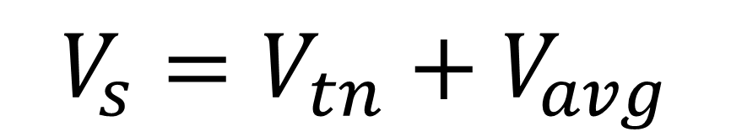
Substitution
Our signal can be the summation of a signal perfectly centered at 0 (V_{tn}), and
A steady state DC signal (V_{avg})
$$V_{s}=V_{tn}+V_{avg}$$

Slide 29
RMS Value
How can the summation be concurrently, obtained? Remember the average value is not available to the end of the sampling?

Slide 30
Accumulation of Samples Squared
Notes:
So if you keep a running addition of samples then square them at the end this will be what is subtracted.

Slide 31
Key Take Away
To find the RMS value of a signal an accumulation of the samples must be done along with an accumulation of the square of the samples.
With these two summations the calculation can be done quickly after the 59th sample.

Slide 32
Average Power Calculation

Slide 33
Calculation from Accumulation

Slide 34
Power Calculation (cont)

